Slide 1
Path to be a Data Scientist
Shahriar’s Analytical Academy

Slide 2
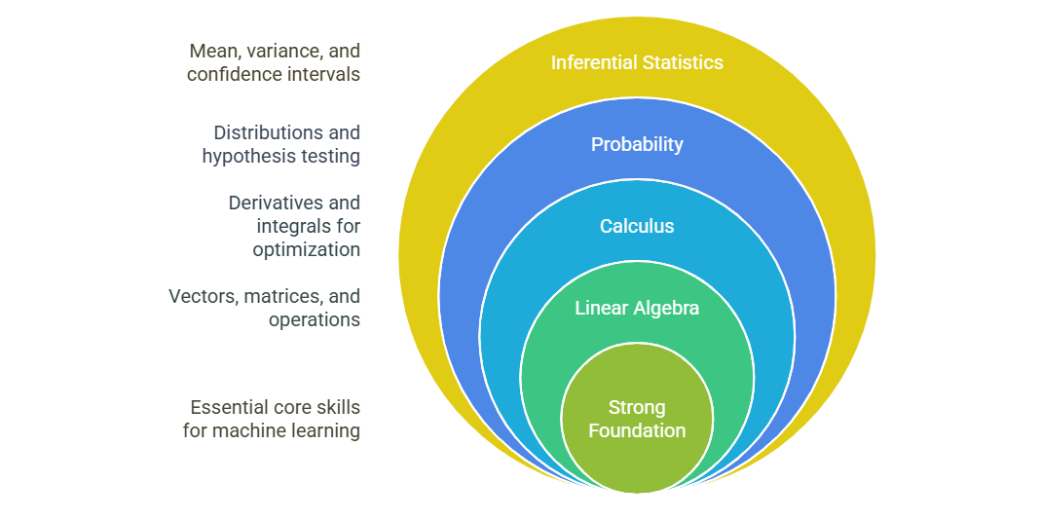
Step 1 - Build a Strong Foundation in Mathematics and Statistics
Notes:
To become a data analyst, it's crucial to start with a solid understanding of mathematics and statistics, as these concepts are fundamental to data analysis and machine learning.
Linear Algebra: Begin by studying linear algebra concepts such as vectors, matrices, and eigenvalues. Understanding these will help you process and manipulate data, especially when dealing with large datasets in machine learning algorithms.
Matrix Operations: Learn how to perform matrix operations like multiplication, addition, and inversion, which are key to many machine learning models. These operations are used to manipulate and transform data, ensuring the model can learn and predict effectively.
Calculus: Focus on derivatives and integrals, which are essential for optimization algorithms. Derivatives help in understanding the rate of change, which is crucial for algorithms like gradient descent used in machine learning for minimizing error.
Probability and Distributions: Study probability distributions (e.g., normal distribution) and key concepts like hypothesis testing and p-values. These concepts are used to make inferences from data, helping you test assumptions and understand data patterns.
Inferential Statistics: Master basic inferential statistics, such as mean, variance, and confidence intervals, to draw conclusions about data from sample data. Understanding these statistics is essential for making predictions and decisions based on data.

Slide 3
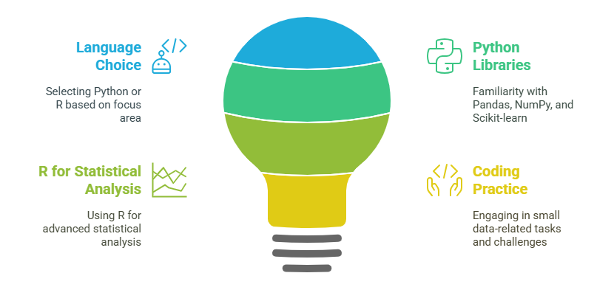
Step 2 – Learn Programming
Notes:
To become a data analyst, one of the most important steps is to learn programming. The two main languages you can choose from are Python and R. Both languages are widely used in the data science field, but they each have their own strengths depending on what you want to focus on. Python is a general-purpose programming language that’s extremely popular in the data analysis community. It’s known for its simplicity, readability, and versatility, which makes it great for everything from data manipulation to building machine learning models. On the other hand, R is more focused on statistical analysis and data visualization. If you’re interested in diving deep into statistics and need to create complex visualizations, R might be a better choice for you.
For Python, you’ll want to get comfortable with some essential libraries. Pandas is one of the most important because it helps you manipulate and clean data with ease. You’ll also use NumPy for numerical operations, especially when working with large datasets or performing mathematical calculations. And when you move into machine learning, Scikit-learn is a must-know library—it provides tools for building and evaluating machine learning models. As for R, you’ll mainly focus on libraries like ggplot2 for data visualization, which is great for making beautiful and informative charts, and dplyr, which is excellent for cleaning and manipulating data.
Learning programming is all about practice. It’s one thing to understand the theory behind Python or R, but to truly become proficient, you need to work on real-world data problems. Start small by taking on simple tasks, such as cleaning a dataset, calculating summary statistics, or visualizing trends. Websites like Kaggle and DataCamp provide tons of beginner-friendly challenges and projects that help you build your skills. By practicing regularly and experimenting with different types of datasets, you’ll gain confidence and develop the practical coding skills needed for a career as a data analyst.

Slide 4
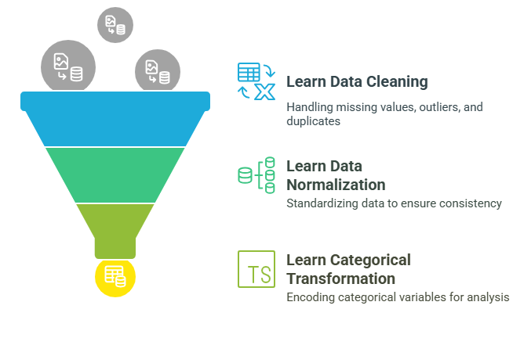
Step 3 - Master Data Manipulation and Cleaning
Notes:
Mastering data manipulation and cleaning is a key step in becoming a data scientist. The first thing you’ll need to learn is how to collect data from sources like CSV files, APIs, or databases. Once you have the data, cleaning it is crucial. You'll often encounter missing values, outliers, and duplicates that need to be handled. Missing values can be filled or removed, outliers might need to be adjusted, and duplicates should be eliminated to ensure accuracy.
Next, you'll need to normalize or standardize the data to prepare it for analysis. This ensures that all features are on a similar scale, especially important for machine learning models. Categorical variables need to be transformed into numerical formats using techniques like one-hot encoding or label encoding.
Data preprocessing is essential because clean, well-prepared data leads to more accurate models. Without proper cleaning and transformation, even the best models can produce misleading results.

Slide 5
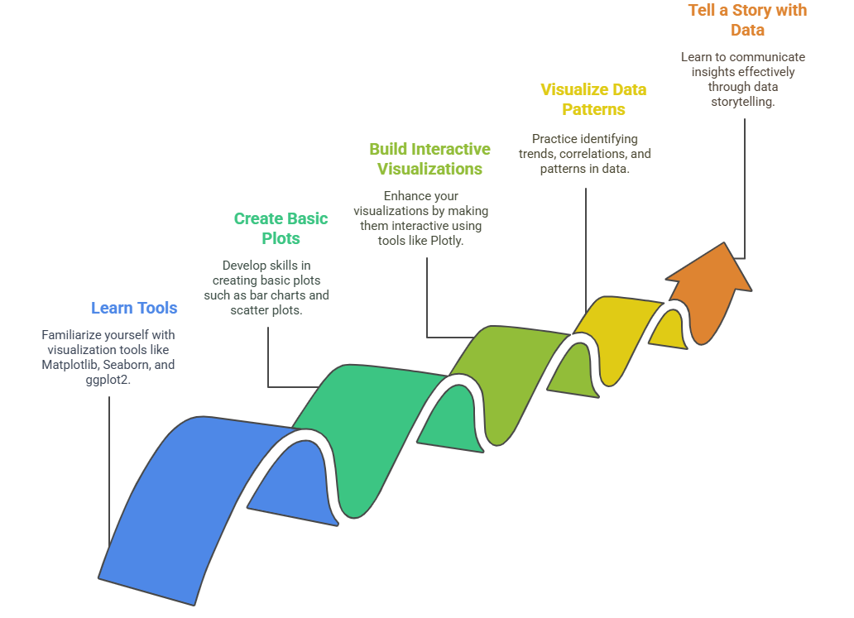
Step 4 - Gain Knowledge in Data Visualization
Notes:
You'll need to learn visualization tools like Matplotlib and Seaborn in Python, or ggplot2 in R, which help you create clear and insightful visual representations of data. These tools allow you to build basic plots like bar charts, scatter plots, and histograms to show distributions, trends, and relationships in your data.
Once you’re comfortable with basic visualizations, you can move on to interactive visualizations using tools like Plotly. Interactive plots allow users to explore data dynamically, which can be particularly useful for presentations or web-based dashboards.
The next step is to practice visualizing trends, correlations, and patterns in data. Visualizing these aspects can help reveal important insights that might not be immediately obvious from the raw data.
Finally, it's crucial to tell a story with data. Good data visualization is not just about creating pretty charts; it’s about communicating the insights clearly and persuasively. By presenting your findings in a way that is easy to understand, you can help decision-makers grasp complex ideas and make informed choices.

Slide 6
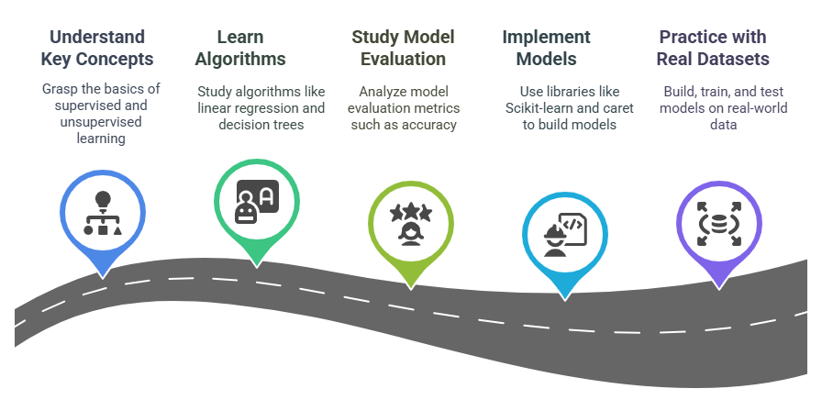
Step 5 - Learn Machine Learning
Notes:
Learn Machine Learning is an essential step in advancing as a data analyst. Start by understanding key machine learning concepts like supervised and unsupervised learning. In supervised learning, the model is trained on labeled data, where the input is mapped to the correct output. In unsupervised learning, the model works with unlabeled data to identify patterns or groupings.
Next, familiarize yourself with some basic machine learning algorithms. Linear regression is used for predicting continuous values, while decision trees help with classification and regression tasks. Clustering algorithms, like k-means, are commonly used in unsupervised learning to group data points into clusters based on similarity.
It’s also important to understand how to evaluate models. Key metrics like accuracy, precision, and recall help you assess the performance of your models. Accuracy measures the overall correctness, while precision and recall are more focused on the performance related to specific classes or categories.
To put theory into practice, start implementing machine learning models using libraries like Scikit-learn in Python or caret in R. These libraries provide easy-to-use functions for building, training, and testing models.
Finally, practice building, training, and testing machine learning models on real datasets. This hands-on experience will help solidify your understanding and give you the skills to apply machine learning techniques to solve real-world problems.

Slide 7
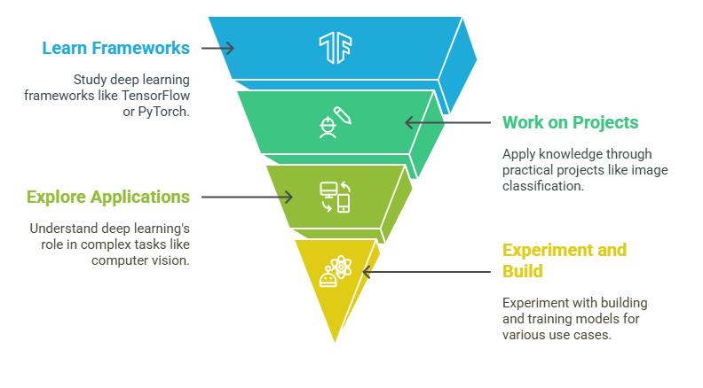
Step 6 - Explore Deep Learning (Optional but Recommended)
Notes:
Deep Learning (Optional but Recommended) is the next step if you want to deepen your knowledge and skills in data science, especially if you're interested in more complex tasks. Start by learning the basics of neural networks, which are the foundation of deep learning. Understand how activation functions work, enabling the network to make decisions, and study backpropagation, the process that helps the network learn from its errors and improve its performance.
Once you grasp the fundamentals, dive into deep learning frameworks like TensorFlow or PyTorch. These frameworks simplify the process of building and training deep learning models, providing pre-built functions and tools for creating powerful neural networks.
To put your knowledge into practice, start working on projects like image classification, natural language processing (NLP), and time-series forecasting. These projects will allow you to explore different types of data and deepen your understanding of how deep learning can be applied to various problems.
Deep learning has many powerful applications, especially in complex fields like computer vision (recognizing objects in images or videos) and AI (creating systems that can simulate human intelligence). By experimenting with deep learning models for these use cases, you can see how they solve challenging problems and help drive innovations.
Finally, building and training deep learning models for various projects will give you hands-on experience and confidence in using these advanced techniques. Though deep learning is often more resource-intensive and requires larger datasets, mastering it can open doors to exciting opportunities in AI and data science.

Slide 8
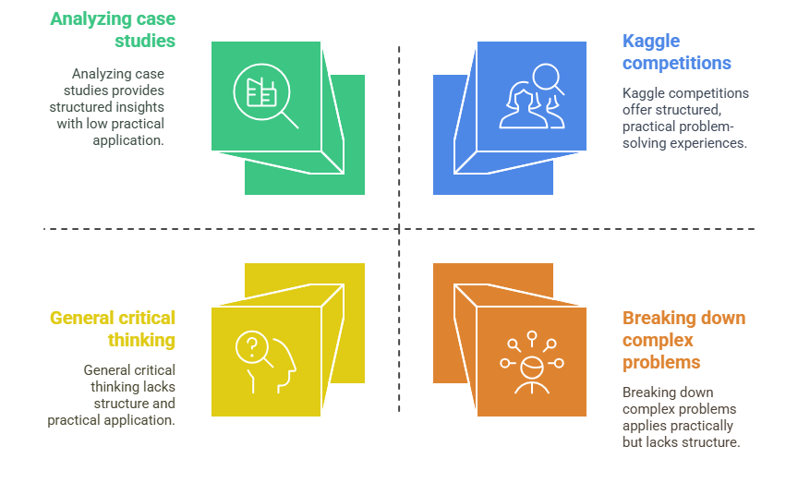
Step 7 - Develop Problem-Solving and Analytical Thinking Skills
Notes:
Develop Problem-Solving and Analytical Thinking Skills is key to becoming a strong data analyst. Start by practicing real-world problems on platforms like Kaggle, where you can solve challenges and learn from other solutions. To tackle complex issues, break them into smaller, manageable parts and use a structured approach—collect, clean, explore, model, and evaluate data.
Studying case studies helps you understand how data science is applied in different industries, offering insights into real-world applications. Focus on critical thinking by using data to drive decisions and insights, ensuring your solutions are data-driven and effective. This approach will help you become better at analyzing and solving data-related challenges.

Slide 9
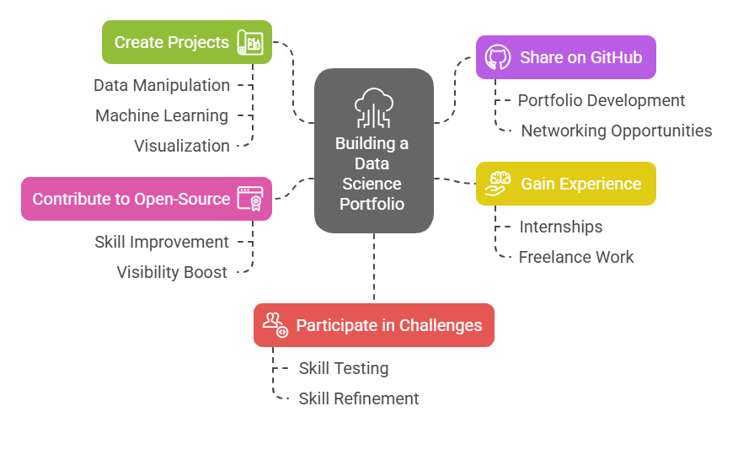
Step 8 - Build a Portfolio and Gain Experience
Notes:
Build a Portfolio and Gain Experience is essential for showcasing your abilities as a data analyst. Start by creating projects that highlight your skills in data manipulation, machine learning, and visualization. These projects will demonstrate your technical proficiency and ability to solve real-world problems.
Share your work on platforms like GitHub to build an online portfolio. This allows potential employers or collaborators to see your projects and contributions. In addition to personal projects, gaining hands-on experience through internships or freelance opportunities will provide practical experience and help you apply what you’ve learned in real-world settings.
Contributing to open-source data science projects can also improve your skills, increase your visibility in the community, and give you valuable collaborative experience. Finally, participating in data science challenges (such as those on Kaggle) will allow you to test and refine your skills while competing with others and solving complex problems. This combination of projects, experience, and challenges will make your portfolio stand out.

Slide 10
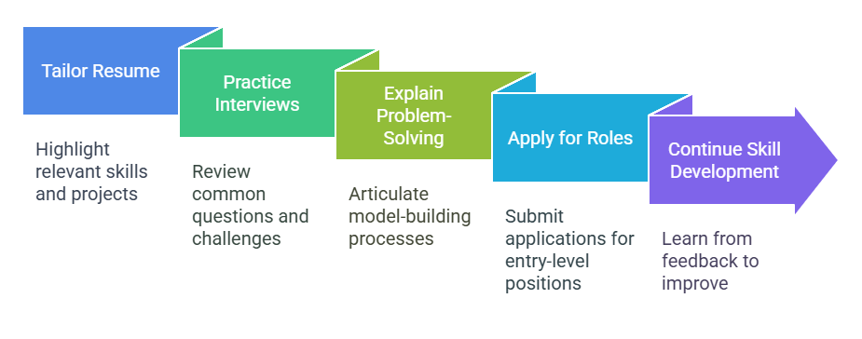
Step 9 - Apply for Data Science Jobs
Notes:
Apply for Data Science Jobs involves taking the final steps to transition from learning to a professional data science career. Start by tailoring your resume to emphasize your relevant skills, projects, and hands-on experience. Make sure to highlight your expertise in areas like data manipulation, machine learning, and data visualization to catch the attention of hiring managers.
Prepare for interviews by reviewing common data science questions and practicing coding challenges. It's important to be ready to discuss your problem-solving approach, your model-building process, and how you use analytical thinking to tackle data-related challenges.
Start by applying for entry-level data science roles or internships to gain professional experience and build your career. During this time, continue to build your skills and learn from feedback to refine your approach and increase your chances of landing your desired job. With continuous improvement and determination, you’ll be well on your way to securing a data science position.

Slide 11
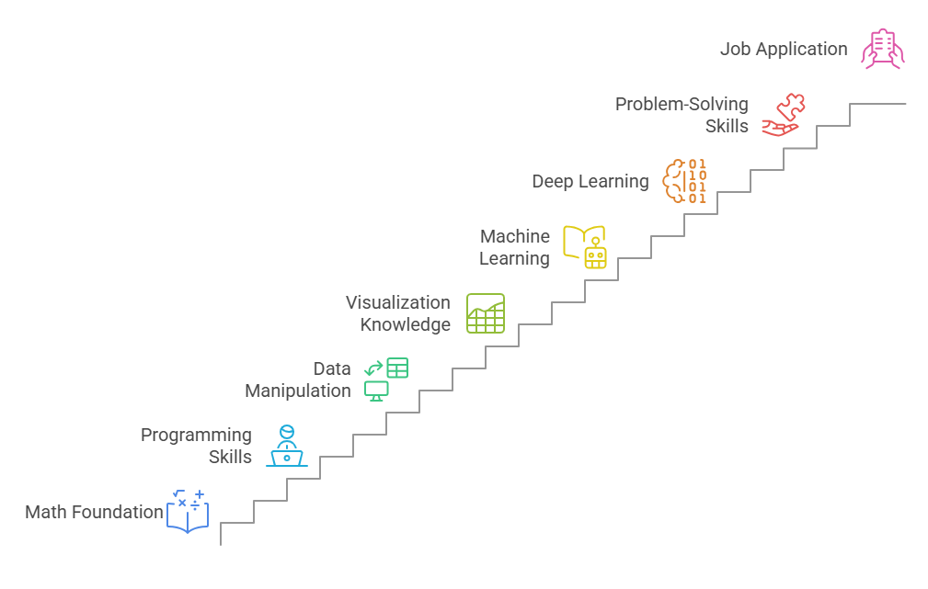
Key learning points of this lesson
Notes:
In this lesson the key things we have learnt that A solid understanding of linear algebra, probability, statistics, and calculus is essential for analyzing data and building machine learning models. These mathematical concepts provide the foundation for understanding algorithms and optimizing model performance.
Proficiency in programming languages like Python or R, and knowledge of essential libraries such as Pandas, NumPy, and Scikit-learn, are crucial for data manipulation and model building. These tools enable data scientists to process data, create models, and generate meaningful insights efficiently.
Learning how to preprocess, clean, and transform data is crucial because real-world data is often messy and unstructured. This step ensures that data is in a usable format for analysis and modeling, which is vital for obtaining accurate results.
Developing critical thinking and problem-solving skills is key to breaking down complex data problems, designing effective solutions, and optimizing algorithms. These skills help data scientists approach challenges methodically and make informed decisions during the analysis process.
Familiarizing yourself with fundamental machine learning concepts and algorithms, such as supervised and unsupervised learning, helps in building predictive models. Understanding these techniques allows data scientists to choose the right algorithms and apply them effectively for tasks like classification, regression, and clustering.
4o

Slide 12
Thank You!
Shahriar’s Analytical Academy

